Slide 1
ShopEreum App Presentation

Slide 2
TOC
Team
Overview
Sequence Diagram
App Feature and View

Slide 3
SmartChainers
SKPaik
SMAlam
MSaha
ARahim
Roman
Imran

Slide 4
Overview
This is a ecommerce application.
You can buy furniture from here with your Ether Wallet.

Slide 5
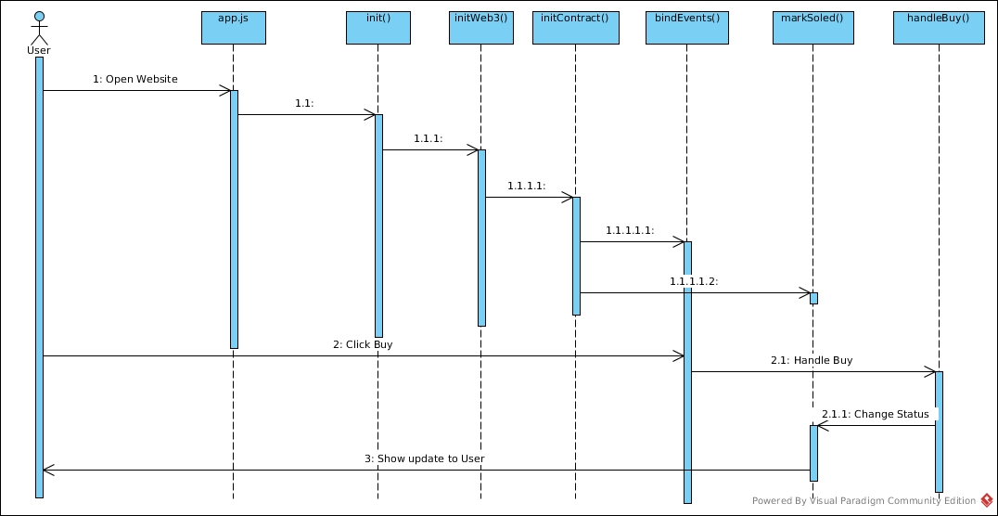
Sequence Diagram

Slide 6
Project objective
L

Slide 7


App Feature and View

Slide 8
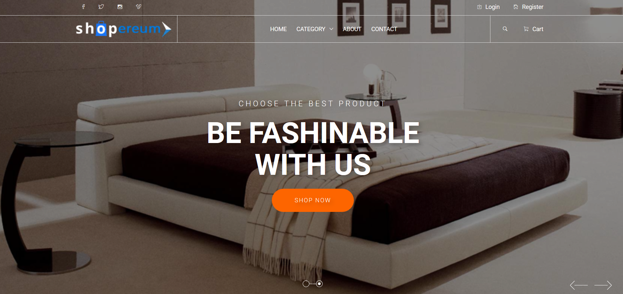
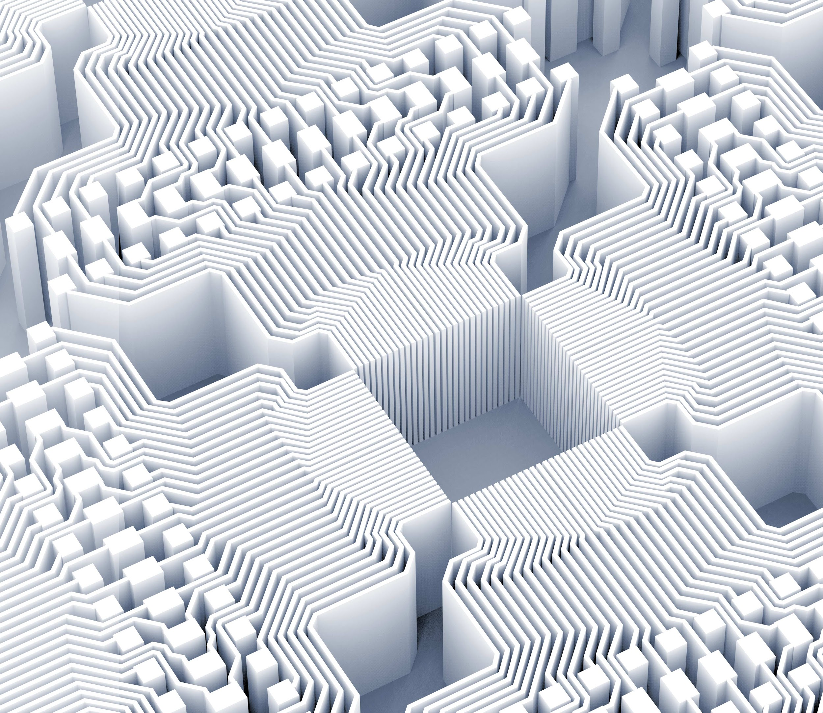
View on desktop

Slide 9
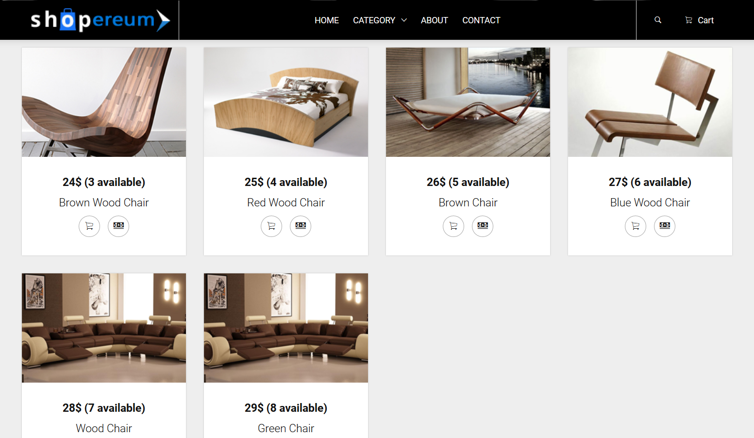
View on desktop

Slide 10
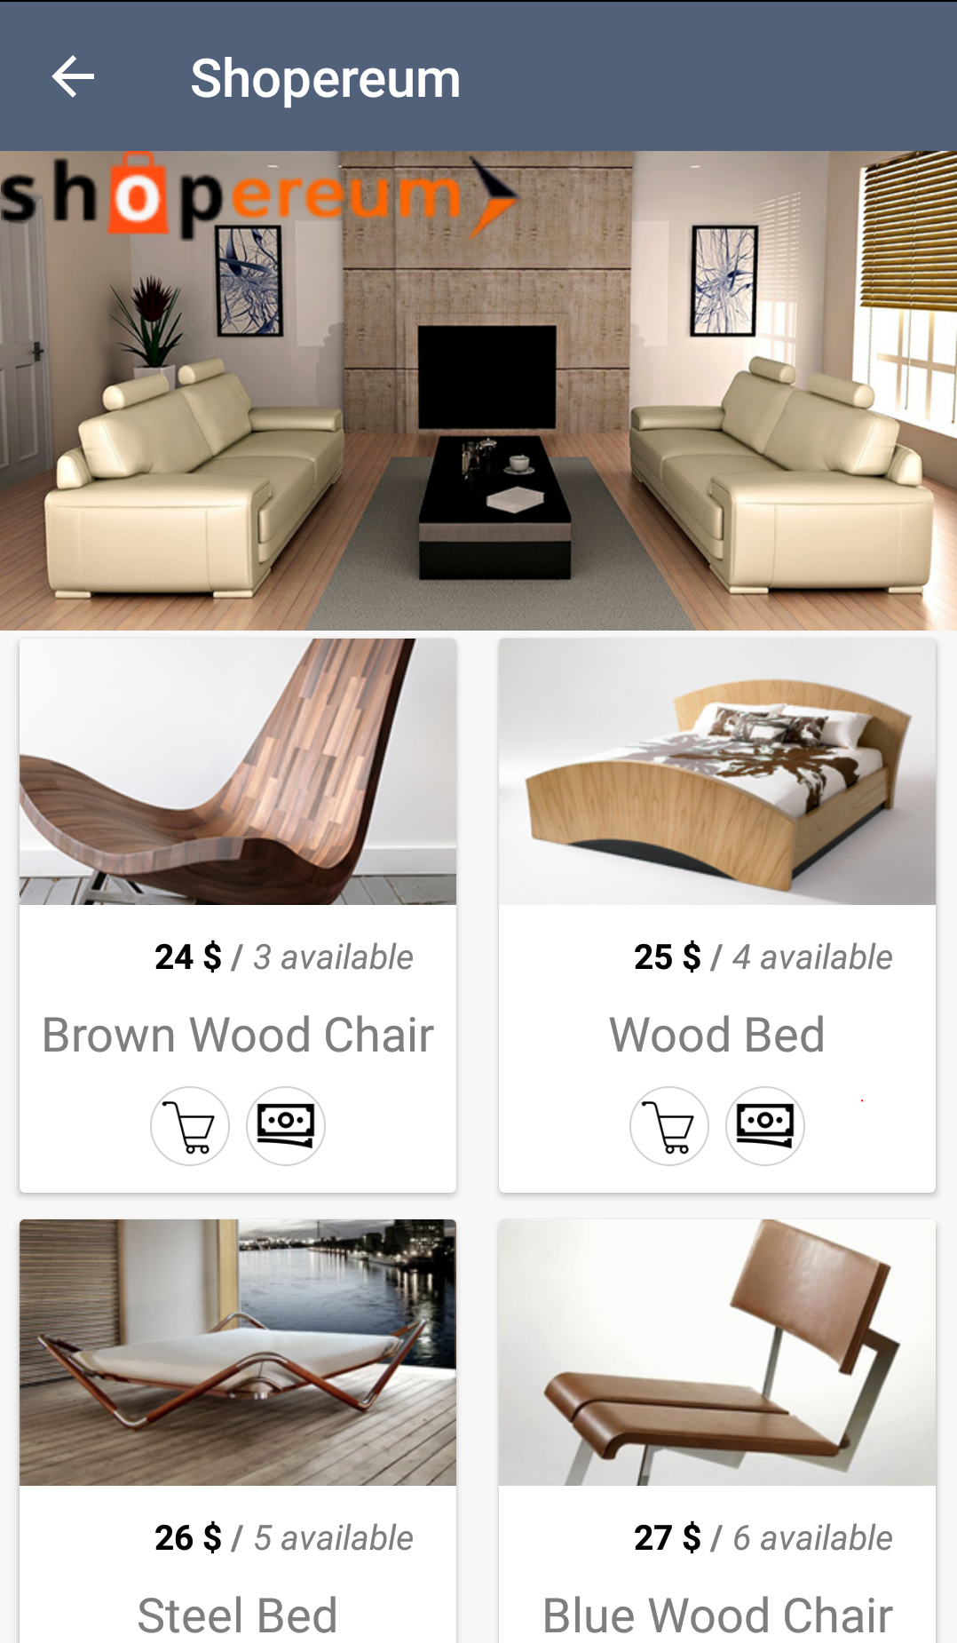
Mobile View

Slide 11
Thank you!
?

